Slide 1
The Cuban Health System – it starts with human development:
Presentation to National Cuban Solidarity Weekend
Ian Powell
Former Executive Director, Association of Salaried Medical Specialists
Health commentator & blogger
Former Christchurch taxi driver
Christchurch
15 August 2026

Slide 2
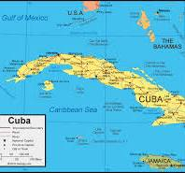
Cuba

Slide 3
Time for human development:
Lucy Larcom
Young woman in early 19th century in Lowell, Massachusetts
Wrote poetry in spare time
Employed in a local textile mill in the midst of clattering machinery.
Resigned out of frustration
Her paymaster asked her if she was going to a better paid job
She responded: I am going to where I can have more time

Slide 4
Karl Marx
International Working Men’s Association
Several decades later, in 1865
An ocean away
“Time is the room of human development”

Slide 5
Marx & Engels
Communist Manifesto
“…the free development of each is the condition for the free development of all”

Slide 6
Constitution (2019): Preamble
We the people of Cuba, inspired by the heroism and patriotism of those that fought for a free, independent, sovereign, and democratic homeland of social justice and human solidarity, forged through the sacrifice of our ancestors;
By indigenous peoples and slaves………

Slide 7
Political Foundations: Article 2
Cuba is a democratic, independent and sovereign, organised by all and for the good of all….founded by the labor, dignity, humanism and ethic of its citizens for the enjoyment of liberty, equity, justice, and equality, solidarity, and individual and collective well-being and prosperity.

Slide 8
Economic Foundations: Article 18
…Cuba is governed by a socialist economic system based on ownership by all people of the fundamental means of production as the primary form of property as well as the planned direction of the economy, which considers, regulates and monitors the economy according to the interests of the society.

Slide 9
Cuban Economy: serves the people
(not the other way round)
Emphasises social welfare programmes, providing subsidised education, healthcare, and food to its citizens
Services sector is the largest contributor to GDP (nearly 74%); includes healthcare and tourism.
Contrast with capitalism: wealth accumulation through appropriation of surplus value the primer driver.
Contrast at core of US hostility since 1959

Slide 10
Constitution on healthcare
All citizens have the right to life, physical and moral integrity, justice, security and peace, health, education, culture, recreation, sports and to their holistic development.
Public health is a right of all people. The state is responsible for guaranteeing access at all levels and free of charge.
State guarantees the right to a healthy home.
State responsibility to ensure all people have the right to a healthy and adequate diet.

Slide 11
Cuban health system:
Structures follow functions
Focus on prevention (population health)
Impact of escalating US economic warfare
Community health centres – family doctors and nurses; primary care, prevention care, neighbourhood focus, dental surgery, hospital specialist outpatient clinics, small DHB population size.
District hospitals – secondary care, 24/7 acute care and emergency departments, complex conditions; surgery.
Specialised hospitals – tertiary care; lower volume, higher complexity conditions

Slide 12
Health outcomes
NZ health targets – selective; things that can be readily counted; but exclude political inconvenient (acute hospital admissions)
Cuba – outcome focussed; system-wide
Life expectancy
Immunisation/vaccinations

Slide 13
Life Expectancy
(World Bank data, 2025)
Cuba: 79.5 years
US: 79.4 years
Central America: 75.8 years
South America: 76.6 years
Caribbean: 73.4 years
New Zealand: 83.1 years

Slide 14
Immunisation Rates
Cuba 99%
United Kingdom 90%
United States 90%
Canada 89%
Australia 87%
New Zealand 87%

Slide 15
Covid 19 Vaccination Rates
(2023 or 2024)
Cuba 97.7%
Canada 89.5%
NZ 83.8%
US 79.1%
Germany 77.1%

Slide 16
Registered Medical Doctors
(per 10,000 people)
Cuba | 94
Sweden | 72
Germany | 46
Australia | 40
New Zealand | 38
Canada | 29
United States | 27

Slide 17
Overseas Medical Missions
Provide medical services to underserved regions; over 30k doctors
Focus on Latin America, Africa, and Oceania
Made possible by heavy investment in doctor training and numbers
Bolivia
Haiti earthquake

Slide 18
Italy: support for Covid 19 pandemic response (Calabria)
Comprehensive universal health system
Highly developed economy; 3rd largest national economy in the European Union and the 8th-largest in the world
Calabria close to Sicily and Greece (2 million population)
Improvished; 20% unemployment (highest in Italy)
51 Cuban doctors arrived in Calabria including cardiologists, paediatricians and surgeons, to provide services in its local hospitals

Slide 19
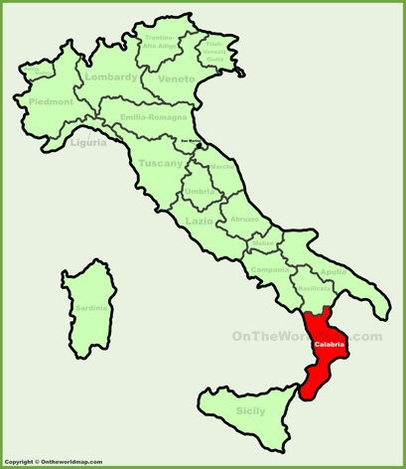
Calabria

Slide 20
Infant Mortality Rate: key barometer of a country’s overall health
2025: total world rate was 25 deaths per 1,000 live births
Latin America & Caribbean 12.6.
European Union 3.4
United States 5.1
Canada 3.9
Australia 2.6
New Zealand 4.8

Slide 21
Cuban infant mortality rate
(Per 1,000 live births)
2018: 4.0
2025 9.9
If the rate of infant mortality had remained unchanged, then approximately 1,800 fewer babies would have died since 2018
Contrast with general pattern of improved rates in the Americas

Slide 22
Behind US brutal hostility to Cuba
Capitalism defined by its prime driver; maximisation of wealth accumulation from both the appropriation of surplus value from workers and degradation of the environment
Role of the many is to serve the economy so that the few can consequentially materially and otherwise benefit.
The more a country migrates towards an economy that serves the people, the more it is a threat to capitalism.
When the economy serving the people is enshrined in a country’s constitution then imperialism (most dangerous form of capitalism) is also threatened.

Slide 23
Summing up Cuban health system (1)
Cuban health system derived from Constitution which is derived from the Revolution.
Shaped by economy designed to serve the people (not to enhance wealth accumulation).
Role of state (national and local) to protect and enhance healthcare as a basic right.
Function before form or structure.
Recognition of importance of sustainable health workforce.

Slide 24
Summing up Cuban health system (2)
Strong emphasis on health promotion and health protection; immunisation.
Strong emphasis on accessible health services – community to tertiary
Strong emphasis on high end science (vaccines).
Strong emphasis on internationalism.
Flows from focus on human development

